Slide 1








<SpaceX Falcon9 First Stage Landing Prediction>
<Aly Mohamed Aly Nasr>
<10 Oct 2022>

Slide 2



OUTLINE
Executive Summary
Introduction
Methodology
Results
Visualization – Charts
Dashboard
Discussion
Findings & Implications
Conclusion
Appendix

Slide 3

EXECUTIVE SUMMARY
Data Collection with API & Web Scraping
Data Wrangling
EDA
EDA with SQL
EDA with Python/Data Visualization
Interactive Visual Analytics with Folium & Dash
ML Predictive analysis
EDA Results
ML Results

Slide 4

INTRODUCTION
Project Background & context
Space X advertises Falcon 9 rocket launches on its website with a cost of 62 million dollars; other providers cost upward of 165 million dollars each, much of the savings is because Space X can reuse the first stage.
The goal of this project is to predict if the first stage will land successfully so that we can determine the cost of a launch.
Problems to solve
What are the factors that contribute to a successful landing?
What is the success rate of said landing?

Slide 5

METHODOLOGY
Data Collection with API
Data collection was done using SpaceX Rest API
The Request was converted into a JSON file using the .json() method
The JSON file was then converted into a pandas Dataframe
The Data was then cleaned and missing values were dealt with.

Slide 6
METHODOLOGY
https://en.wikipedia.org/w/index.php?title=List_of_Falcon_9_and_Falcon_Heavy_launches&oldid=1027686922
Data Collection with Web Scraping
The Data was collected from the Falcon 9 Wikipedia page
The Request was parsed and the HTML tables were extracted
The Date was then converted into a pandas Dataframe

Slide 7
METHODOLOGY
Data Wrangling
In this section, the outcome of the launch was categorized and encoded into a one-hot vector

Slide 8
METHODOLOGY
EDA
In this section, the shape and properties of the Data was explored using SQL
Then, using Python libraries such as Matplotlib and Seaborn we observed the dependencies and correlation of the various features

Slide 9
METHODOLOGY
Interactive Visual Analytics
Building an Interactive Map with Folium
All launch sites were marked on the map
Individual launches were classified according to outcome and color coded then added to the map
Building a Dashboard with Plotly Dash
The Dashboard include pie charts indicating the total number of launches by site and scatter graphs showing the relationship between the launch outcome and the payload mass (KG) for different booster versions

Slide 10
METHODOLOGY
Predictive Analysis
The Data was loaded using numpy and pandas
The Data was then transformed, normalized and split into training and test sets
Different Algorithms were used and optimized by GridSearchSV
The Best Model was found successfully

Slide 11
RESULTS
EDA Results
Data Visualization
Using SQL
Interactive Analytics
Folium Maps
Dashboard
Predictive Analysis Results

Slide 12
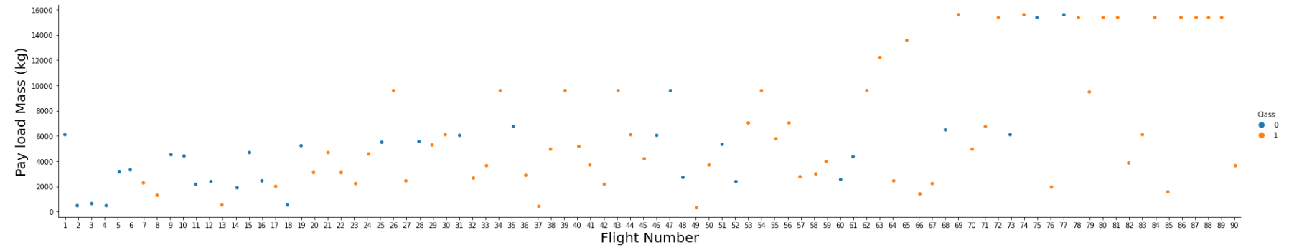
EDA Using Data Visualization
From the Plot We see that the success rate of the landing increases in later launches.
From this we can understand that SpaceX upgraded and optimized the landing methods and learned how to better recover the first stage after many failures
We can see that the first 6 launches were all failures and the success rate only started increasing significantly after the 20th launch, while the Payload mass is observed to increase the success rate

Slide 13
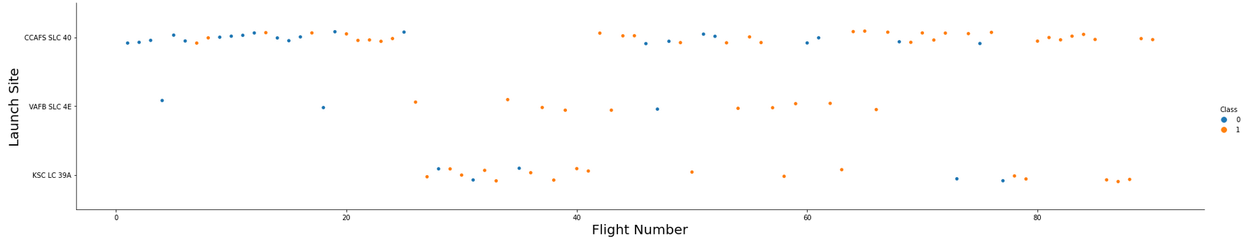
EDA Using Data Visualization
From the Plot We see that the First and last launch sites are used more than the middle one

Slide 14
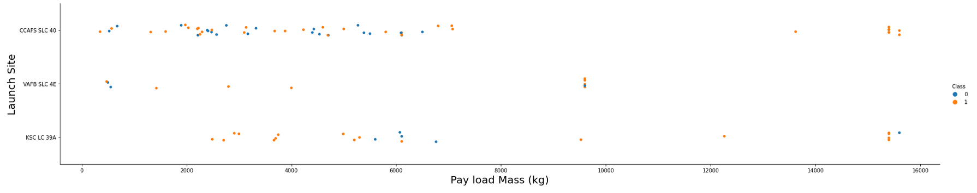
EDA Using Data Visualization
From the Plot We see that the VAFB SLC 4E launch site is only used withing a specific payload mass range and all launched do not reach the 10,000 KG mark

Slide 15
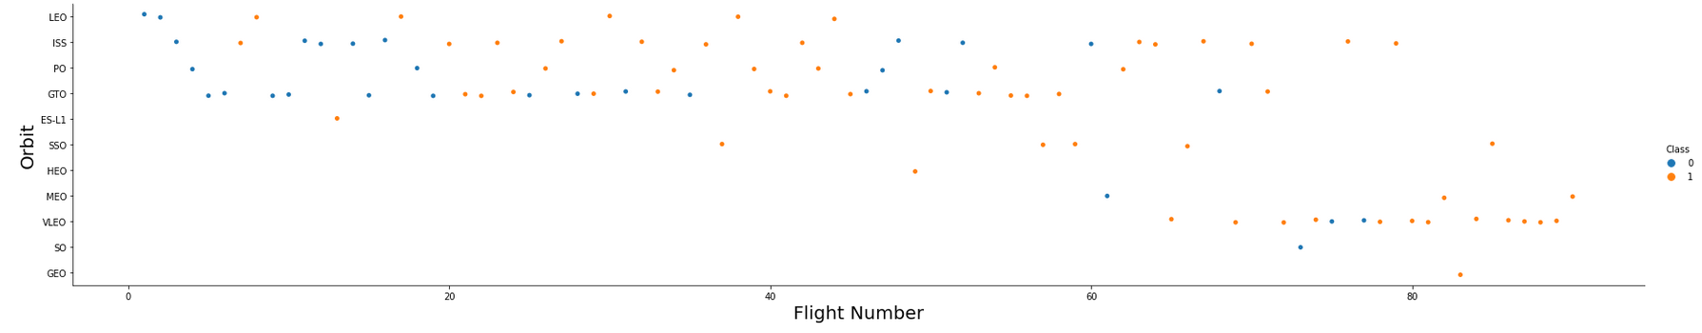
EDA Using Data Visualization
From the Plot We see that some orbits such as the LEO orbits appears correlated to the flight number while no such relation can be observed from GTO orbit
Some orbits have a very small number of example such as GEO, SO and ES-L1 and no insight can be observed from them.

Slide 16
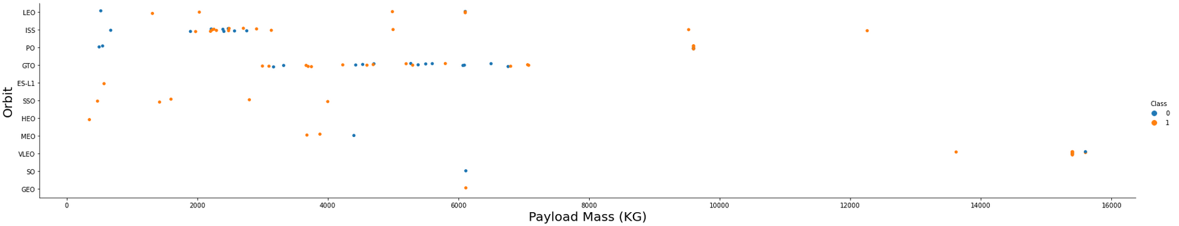
EDA Using Data Visualization
From this Plot it can be observed that some orbits such as PO, LEO and ISS are more successful the heavier the payload is while no such relation can be observed from GTO orbit

Slide 17
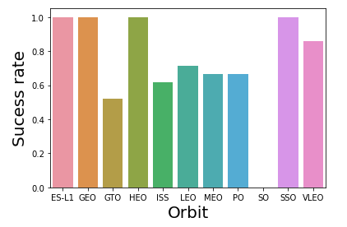
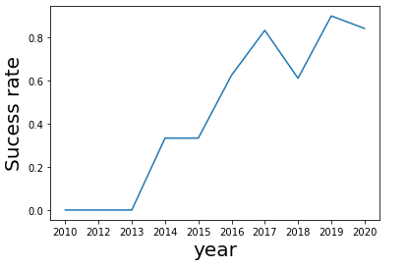
EDA Using Data Visualization

Slide 18

EDA Using SQL
The unique launch sites from the SpaceX data

Slide 19
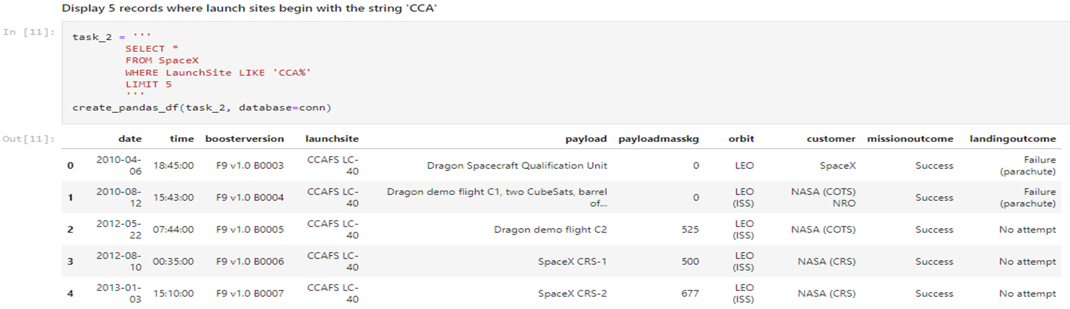
EDA Using SQL
Display 5 records where launch sites begin with `CCA`

Slide 20
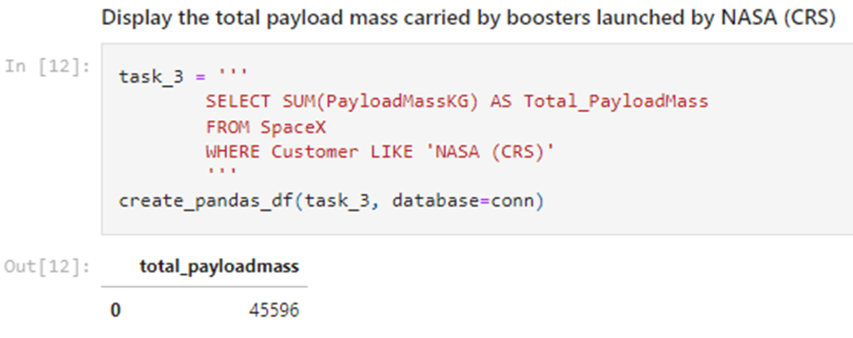
EDA Using SQL
The total payload mass carried by boosters from NASA (KG)

Slide 21
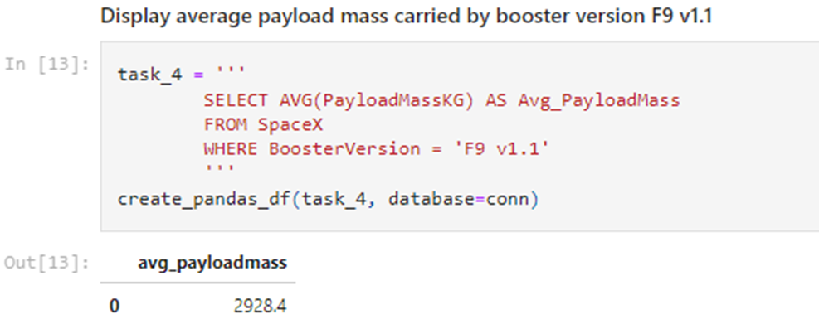
EDA Using SQL
The average payload mass carried by booster version F9 v1.1

Slide 22

EDA Using SQL
The date of the first successful landing outcome on ground pad

Slide 23
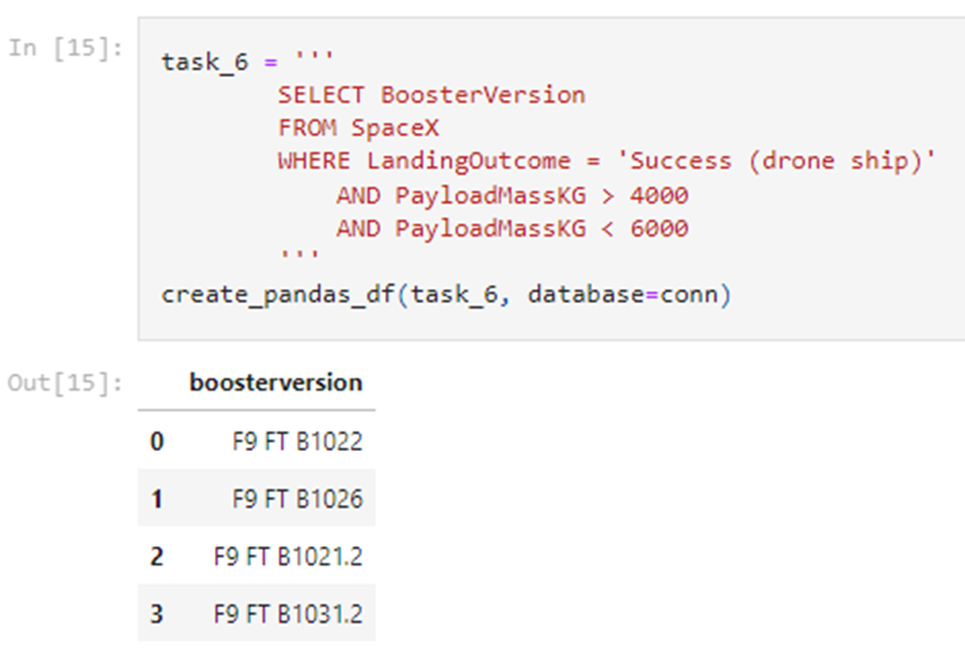
EDA Using SQL
Successful landing with payload mass greater than 4000 but less than 6000 based on booster version

Slide 24
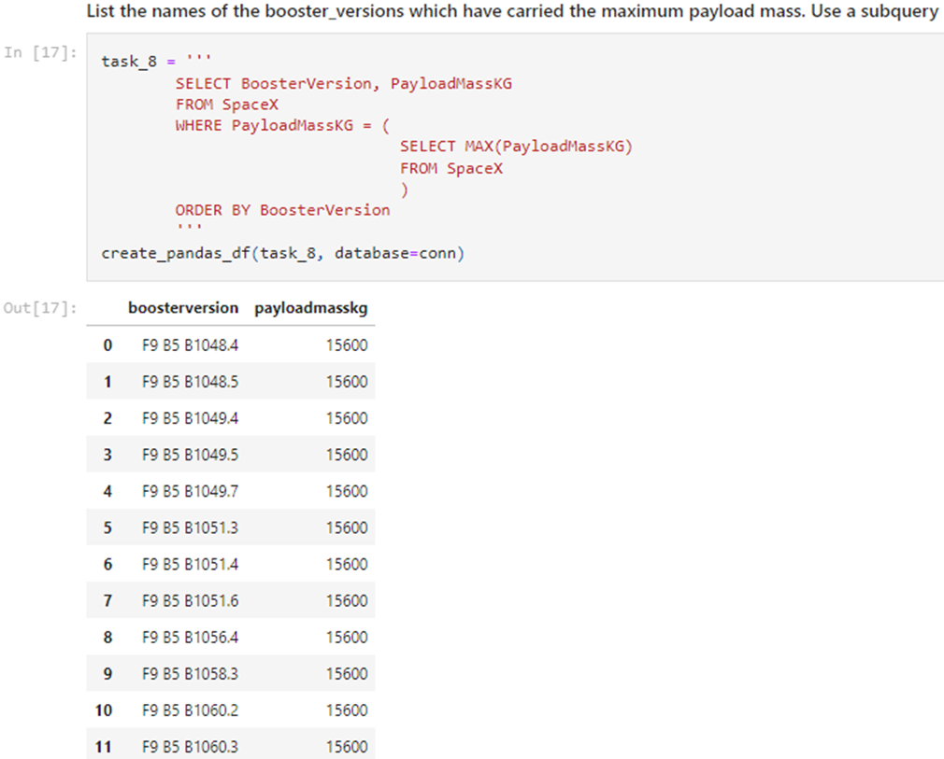
EDA Using SQL
The boosters that have carried the maximum payload mass

Slide 25

EDA Using SQL
Failed landing outcomes in drone ship, their booster version and launch site names for year 2015

Slide 26

EDA Using SQL
The landing outcomes count between 2010-06-04 and 2010-03-20

Slide 27
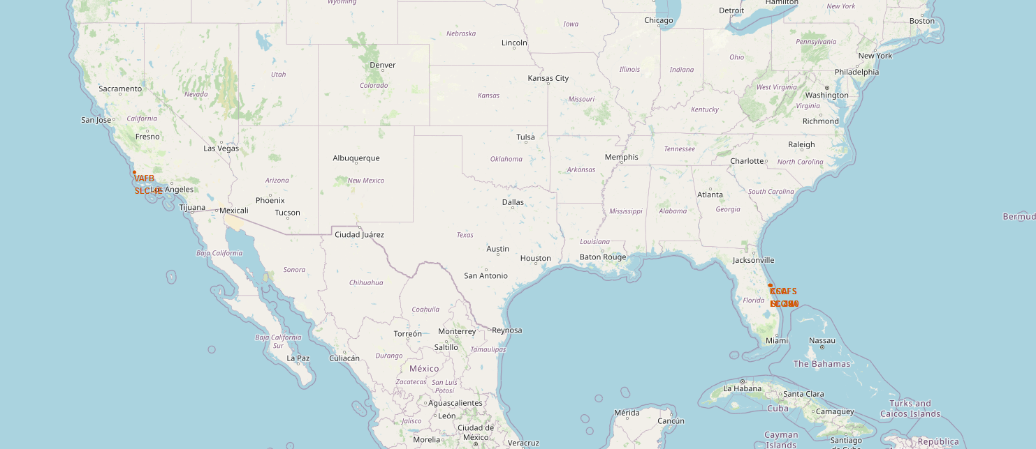
Interactive Analytics Using Folium Maps
The SpaceX launch sites along the coasts of the USA in Florida and California

Slide 28
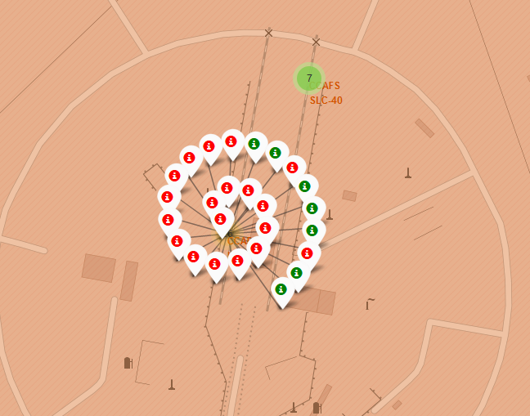
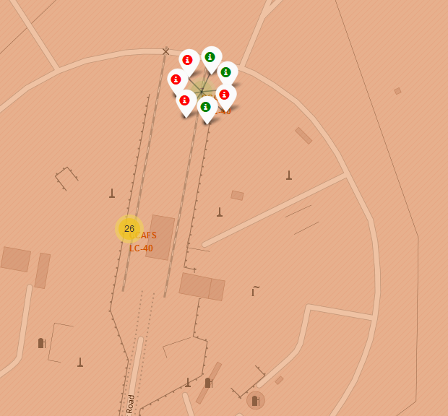
Interactive Analytics Using Folium Maps
The SpaceX launch sites CCAFS LC-40 and CCAFS SLC-40 on map
The green markers represent successful launches

Slide 29
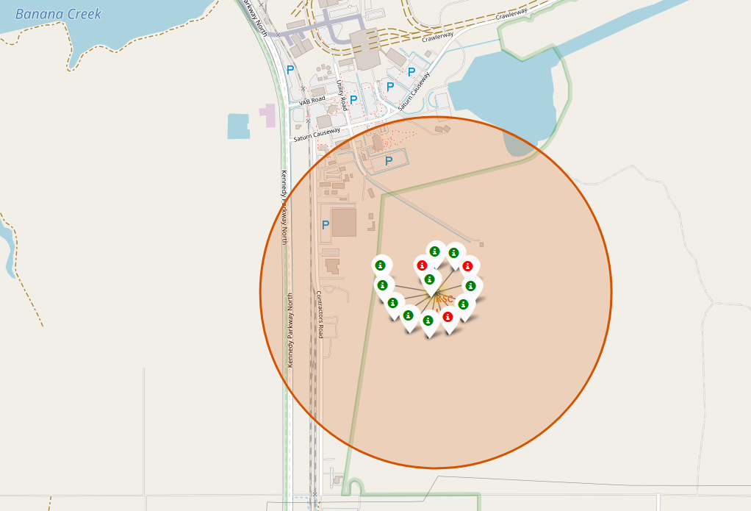
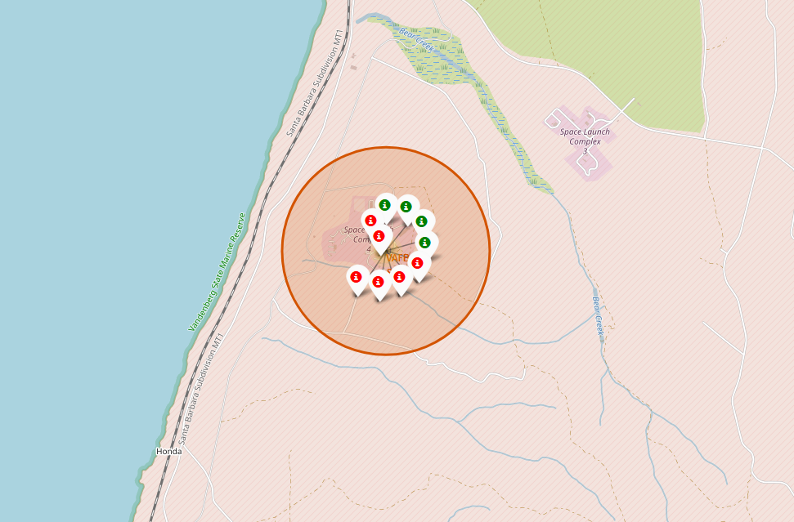
Interactive Analytics Using Folium Maps
The SpaceX launch sites KSC LC-39A and VAFB SLC-4E on map
The green markers represent successful launches

Slide 30
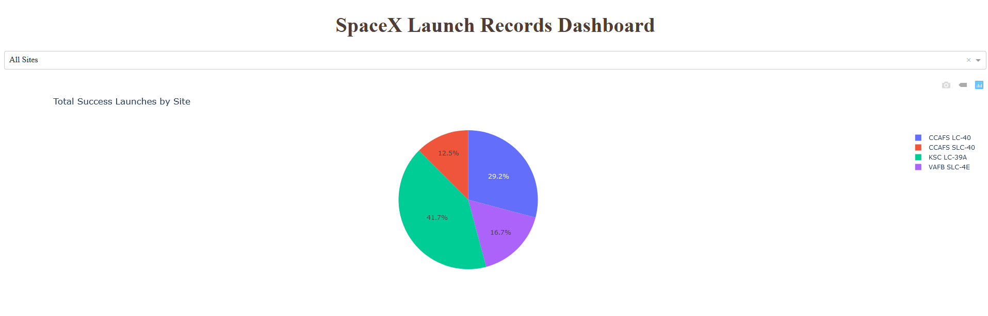
Interactive Analytics Using Dashboard
This pie chart indicates the success rate of launches by launch site
It can be seen that the KSC LC-39A has the highest success rate

Slide 31
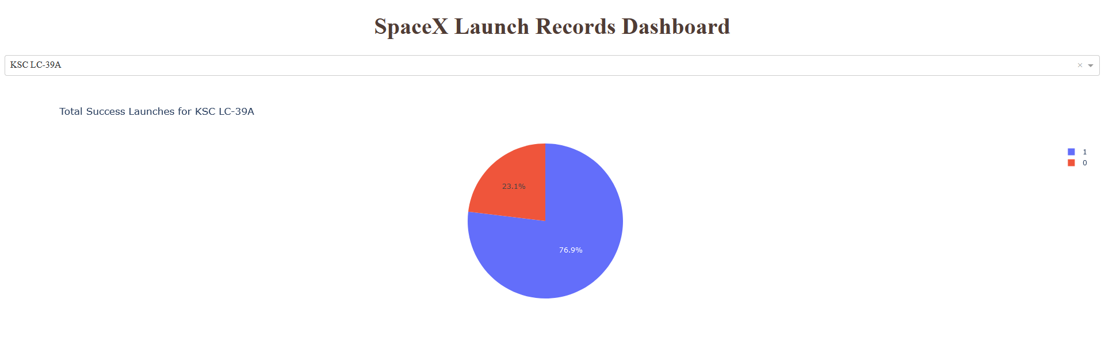
Interactive Analytics Using Dashboard
This pie chart indicates the success rate of launches in KSC LC-39A

Slide 32
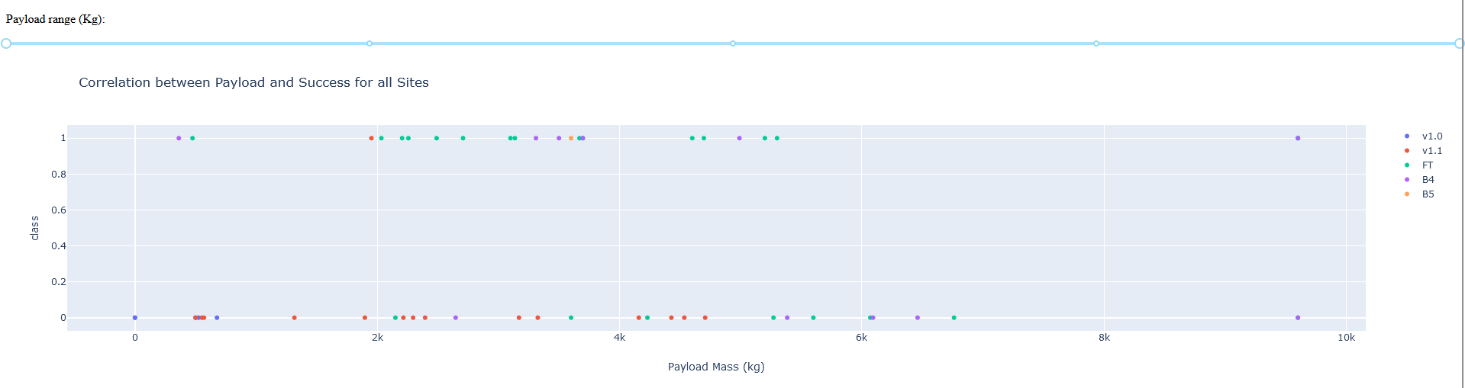
Interactive Analytics Using Dashboard
Scatter plot of Payload vs Launch Outcome for all sites
It can be observed that higher payload mass has lower success rate

Slide 33
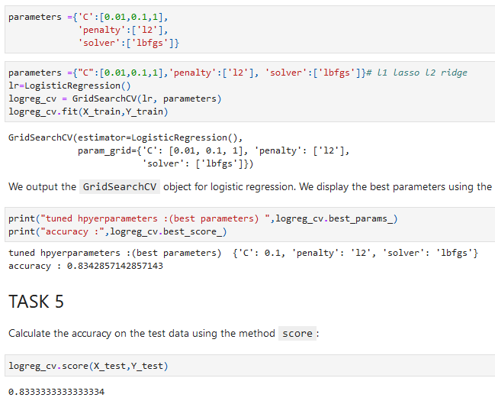
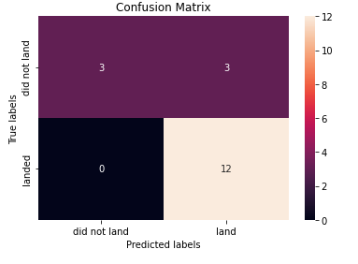
Predictive Analysis Results
Logistic regression Results

Slide 34
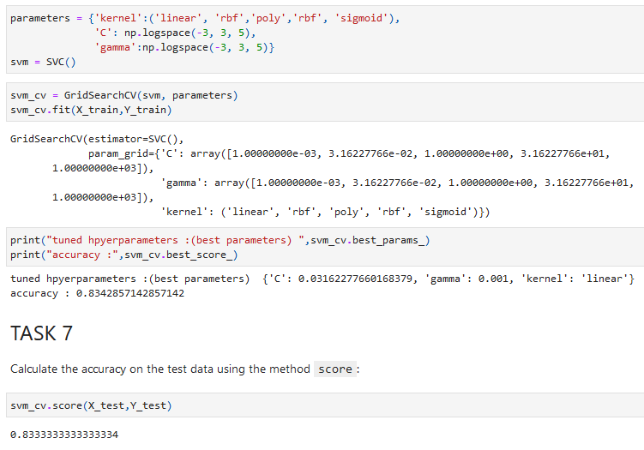
Predictive Analysis Results
SVM Results

Slide 35
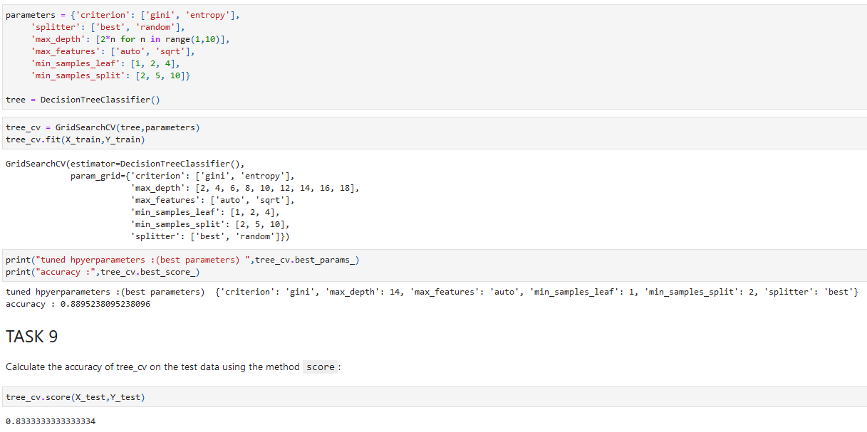
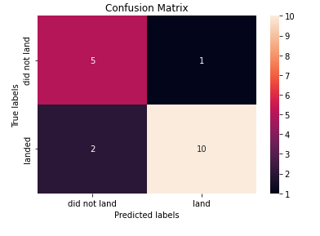
Predictive Analysis Results
Decision Tree Results

Slide 36
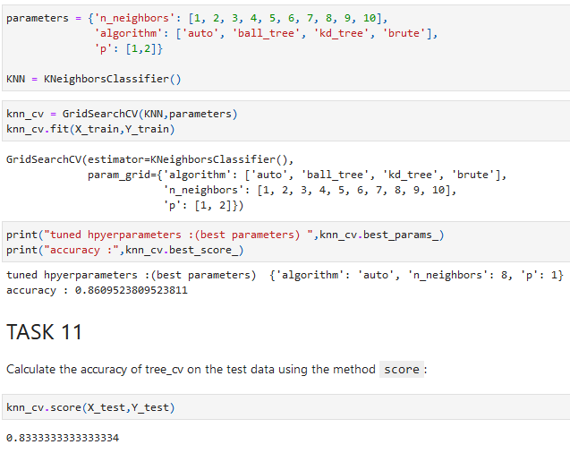

Predictive Analysis Results
KNN Results

Slide 37
Predictive Analysis Results
The model with the best performance so far is the Decision Tree Model
It has the score of 0.889 which is the highest so far in the training set
The test set score is not significantly different from other models at 0.8333
It can be observed from the confusion matrix that this model is more balanced while other models have a problem with False-positive
The optimal parameters are

Slide 38





<Thank You>
<Aly Mohamed Aly Nasr>
<10 Oct 2022>

